Slide 1

Early Detection and Treatment of Severe Sepsis and Septic Shock TEAM Vennela.Kosanam Narsi.Sanivarapu Jagannath.Patro Siva.Pavuluri

Slide 2
MEET THE TEAM
NARSI REDDY
SANIVARAPU
VENNELA
KOSANAM
JAGANNATH PATRO ALLUPATHI
VENKATA SIVANNARAYANA.PAVULURI
PROJECT MANAGER
DATA SCIENTIST
REPORT DEVELOPMENT
DATA ENGINEER
DATA ANALYST

Slide 3
What Is Sepsis:
“Sepsis is caused when the body’s immune system becomes overactive in response to an infection, causing inflammation which can affect how well other tissues and organs work.”

Slide 4
Surviving Severe Sepsis and Septic Shock
More than 1.5 million people get sepsis each year
One in three patients who die in a hospital have sepsis
Severe sepsis is the leading cause of death in the non-coronary ICU
The New York State 2016 Sepsis Care Improvement Initiative reported an overall severe sepsis and septic shock mortality rate of 25%-32%

Slide 5
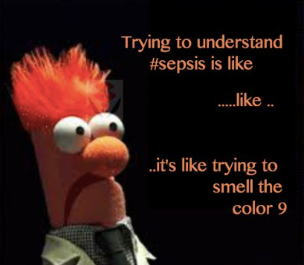

Slide 6
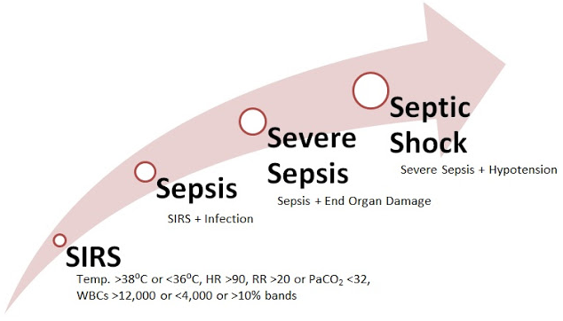

Slide 7
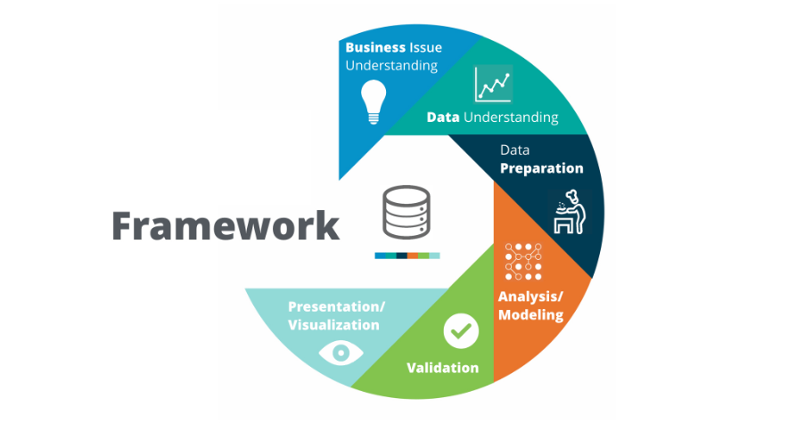
CRISP METHODOLOGY
CRISP Methodology

Slide 8
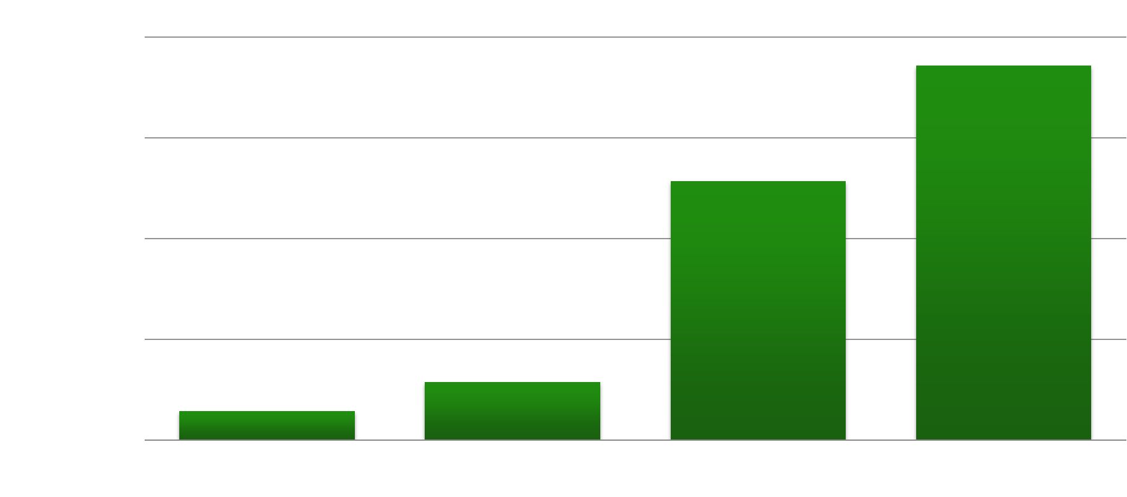
Problem
Sepsis is a life-threatening medical condition that arises from the body's inflammatory response to an infection. It can lead to tissue damage, organ failure, and death.
One of the main challenges with sepsis is that it can be difficult to diagnose quickly. Symptoms like fever, elevated heart rate, and confusion mimic other conditions early on.
Delayed diagnosis is a major contributing factor to the high mortality rates of sepsis, which rises by up to 8% per hour that treatment is delayed.
Clinicians face challenges in manually tracking and analyzing all the vital sign deviations across patients that may indicate sepsis is developing.
There is a need for automated systems that can analyze trends in patient data and detect early signatures of sepsis through predictive analytics.
This can alert clinicians to initiate rapid, goal-directed treatment protocols before sepsis progresses to septic shock.
Early detection and timely interventions are critical to improving patient outcomes and reducing healthcare costs associated with sepsis.

Slide 9
Solution
Technical Approach:
Work with hospitals to acquire retrospective patient data required for model development.
Build data pipelines for acquisition, cleaning, preprocessing and feature engineering.
Train, evaluate and optimize ML algorithms like RNNs to maximize prediction accuracy.
Containerize the model within a prediction API and integrate with hospital systems.
Expected Outcomes:
Increased sepsis detection sensitivity and decreased time-to-detection compared to manual methods.
Reduced patient mortality, complications, and healthcare costs through early diagnosis.
Provide clinicians with data-driven, real-time warnings on sepsis risk to inform care.

Slide 10
Workflow
Workflow
Data Preprocessing:
Model Development:
Data Acquisition:
Use APIs or protocols like FHIR to extract data from EHR systems. Obtain patient consent where needed.
Derive new features like SOFA score, qSOFA score, lab value deltas, age buckets etc.
Explore algorithms like logistic regression, RNNs, CNNs for predictive modeling.
Use cross-validation techniques to evaluate model performance and generalizability.

Slide 11
Deployment
Containerize model within a prediction API using Docker.
Set up hosted prediction API pipeline with tools like Flask, Django.
Integrate API with hospital IT infrastructure and EHR system.
Create dashboard/app to surface predictions to clinicians at point of care.
Monitor and collect performance metrics continuously post-deployment.

Slide 12
Business Perspective
Value proposition:
The solution offers hospitals early identification of high-risk sepsis patients to enable timely intervention, improved outcomes, and potentially reduced length of stay.
Target market:
Hospitals and health systems dealing with a high incidence of sepsis, seeking to improve sepsis management initiatives and reduce mortality rates.
Competitive advantage:
The predictive model provides automated warnings against manual tracking methods, allowing earlier diagnosis and treatment. Integrates with EHRs.
Revenue model:
Recurring software licensing model based on number of hospital beds. Additional fees for integration, maintenance, and training.
Cost structure:
Main costs involved are software development, compute infrastructure, clinical staff for implementation, and customer support.
Key metrics:
Clinical outcomes like sepsis mortality rates, time-to-treatment, and ICU admissions. Operational metrics like adoption rates.
Partnerships:
Partnering with EHR vendors to distribute integrated solutions. Collaboration with research institutions to further improve predictions.
seek

Slide 13
THANK YOU

